Slide 1
SWATCH NEER
TEAM NUMBER : 1
TEAM MENTORS: TARUN ADITYA
TAPASWINI

Slide 2
PROBLEM :
Nowadays due to urbanization and industrial development there is huge contamination of water bodies. This leads to water pollution and death of aquatic life. The increased levels of particulate matter in water bodies decreases the amount of dissolved oxygen in water, posing threat to water animals and the trash disposal decreases the cleanliness and sanity of the water bodies.

Slide 3
IDEA/APPROACH:
Nowadays due to urbanization and industrial development there is huge contamination of water bodies.
This leads to water pollution and death of aquatic life.
So, to decrease the "water Pollution" a bot is created .which can remove the waste and check the pollution level in the water bodies .
The bot helps in finding ppm using TDS meter and pH of water bodies .Bot collects plastic and other noticeable waste from the water bodies.

Slide 4
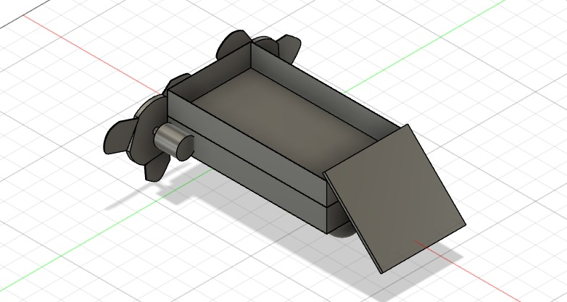

Slide 5
THANK YOU

